Slide 1
Editing Good writing takes time and effort. It should not be rushed.
Fish 290
Thursday Feb 27

Slide 2
3-step editing process (your own work and others):
Fine details: Read through the paper. Use Track Changes to mark any unclear statements, give comments, make edits
Overall structure: Go through checklist (we will make this today). Check that each section/paragraph is doing its job.
Big picture: See Table 1 of “10 Simple Rules for Structuring Papers.” Are there signs that the 10 simple rules are violated? If so, what do they need to change?

Slide 3
1. Fine details
The reader does not know what you know.
Signs you wrongly assumed your reader is also in your brain:
Justification for why your study is needed is missing or weak in the Introduction
Important context is missing (study site, basics of organism’s biology relevant to study)
Pronoun-heavy writing (“It was taken to the lab…” “Temperature affected them…”)
This is why it is necessary to get feedback from someone else!

Slide 4
1. Fine details
Brevity: always try to communicate your message in as few words as possible. Every sentence must serve a purpose.
Why be brief?
Shorter writing is clearer writing
Fluff competes for your reader’s attention and dilutes the main message
Fluff is transparent and gives poor impression of your work
Many journals and grants have strict length limits
Read “Brevity” in Canvas if you need help cutting!

Slide 5
Don’t take a paragraph to say what can be said in one sentence.
(aka, I don’t have much to say but the professor wants a 5-page paper, so here we go!)
(aka ‘Full of doo-doo syndrome’)
There are several factors that contribute to coral bleaching. Two of those factors are increased temperature and decreasing pH. When temperatures get warmer, this can cause corals to become bleached. Similarly, when the water gets more acidic, this stress can also lead to coral bleaching. Exposure to these factors can be both long term, intermediate, and short term. Thus, there are a multitude of factors to consider when trying to understand the root cause of coral bleaching, and researchers should place high emphasis on the combined effects of increased temperature and ocean acidification.
Exposure to warmer and more acidic waters can lead to coral bleaching (Martinez and Colins, 2021).

Slide 6
1. Fine details
Common redundancies to avoid (eliminate words in parentheses):
(already) existing introduced (a new)
(alternative) choices mix (together)
At (the) present (time) never (before)
(basic) fundamentals none (at all)
(completely) eliminate now (at this time)
(continue to) remain period (of time)
(currently) being (still) persists
(currently) underway start (out)
(empty) space
Had done (previously)

Slide 7
A considerable amount of research has shown that apex predators are vitally important for the ocean for a variety of reasons. Without substance, but now with fluff!
Apex predators are important for the ocean.
Without substance.

Slide 8
A considerable amount of research has shown that apex predators are vitally important for the ocean for a variety of reasons.
Apex predators are important for the ocean.
A considerable amount of research has shown that apex predators are vitally important for the ocean for a variety of reasons. First, removing predators can cause trophic cascades that lead to the decline in the quality of habitats (Munoz et al. 2011). In addition, when top predators are reduced, studies have also reported decreases in species richness in the ecosystem overall (Yang et al. 2023).
Better, but still with a minor case of “full of doo-doo syndrome”

Slide 9
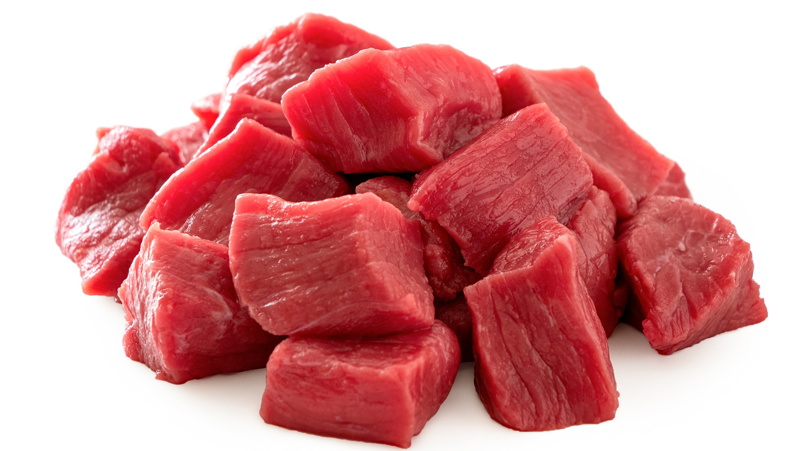
A considerable amount of research has shown that apex predators are vitally important for the ocean for a variety of reasons. First, removing predators can cause trophic cascades that lead to the decline in the quality of habitats (Munoz et al. 2011). In addition, when top predators are reduced, studies have also reported decreases in species richness in the ecosystem overall (Yang et al. 2023). Reductions in the abundance of apex predators due to overfishing can cause trophic cascades that lead to declines in the quality of marine habitats (Munoz et al 2011) and decreases in species richness (Yang et al. 2023). Nice. Concise. All substance, no fat.

Slide 10
Avoid jargon and seek simplicity, brevity, and clarity
Jargon or complex version Simple, brief, and clear version
A considerable amount of much
A considerable number of many
A decreased amount of less
A decreased number of fewer
A majority of most
A number of many
A small number of few
Absolutely essential essential
Accounted for by the fact that because
Adjacent to near
Along the lines of like
An adequate amount of enough
An example of this is the fact that for example

Slide 11
1. Fine details
Brevity: always try to communicate your message in as few words as possible. Every sentence must serve a purpose.
I challenge to you cut 10-20% of the words in your first draft.
Read “Brevity” in Canvas if you need help cutting!

Slide 12
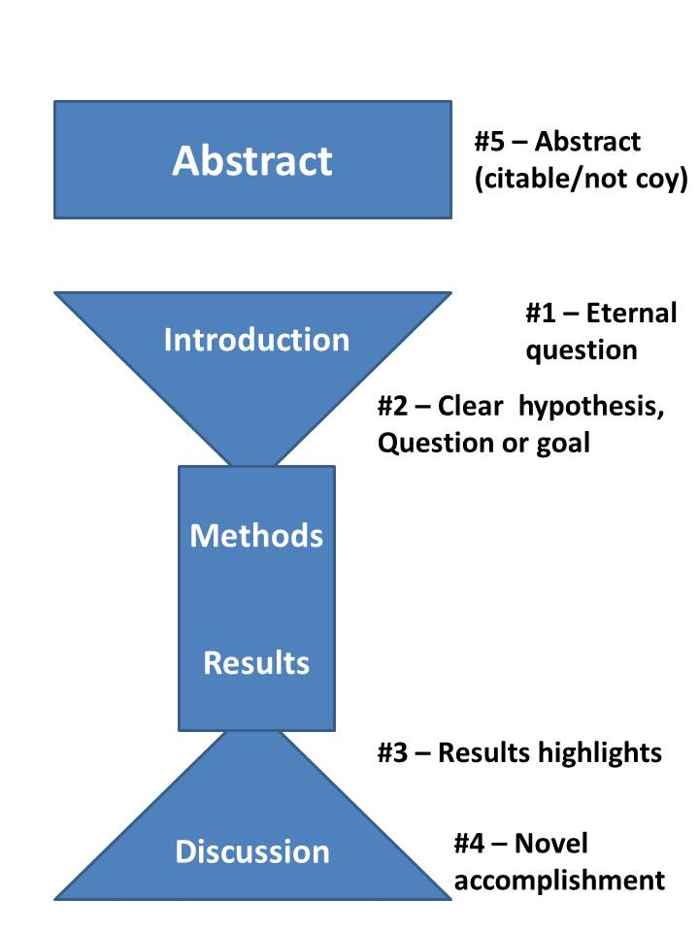
2. Overall structure
Every sentence must serve a purpose.
Every paragraph must also serve a purpose.

Slide 13
2. Overall structure
Every paragraph must serve a purpose.
Use signposts. A signpost is a familiar phrase that marks key statements in your paper. Signposts are needed to guide the reader though technical writing.
Examples:
Intro: “In this study, I tested the relationship between…”
Results/Discussion: “Overall, our experiments showed that…”
Discussion: “In conclusion, we found that…”

Slide 14
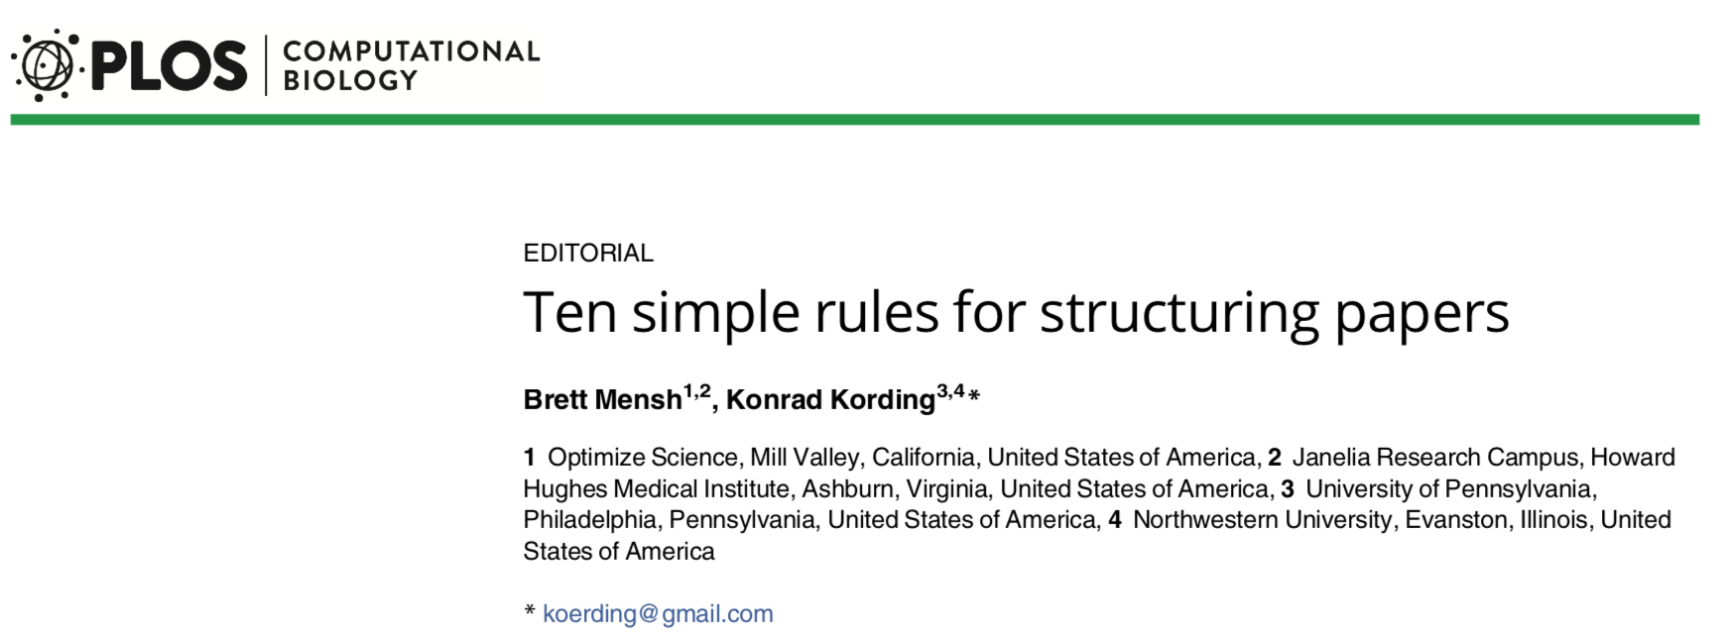
3. Big picture (or, what makes a paper “good”?)

Slide 15
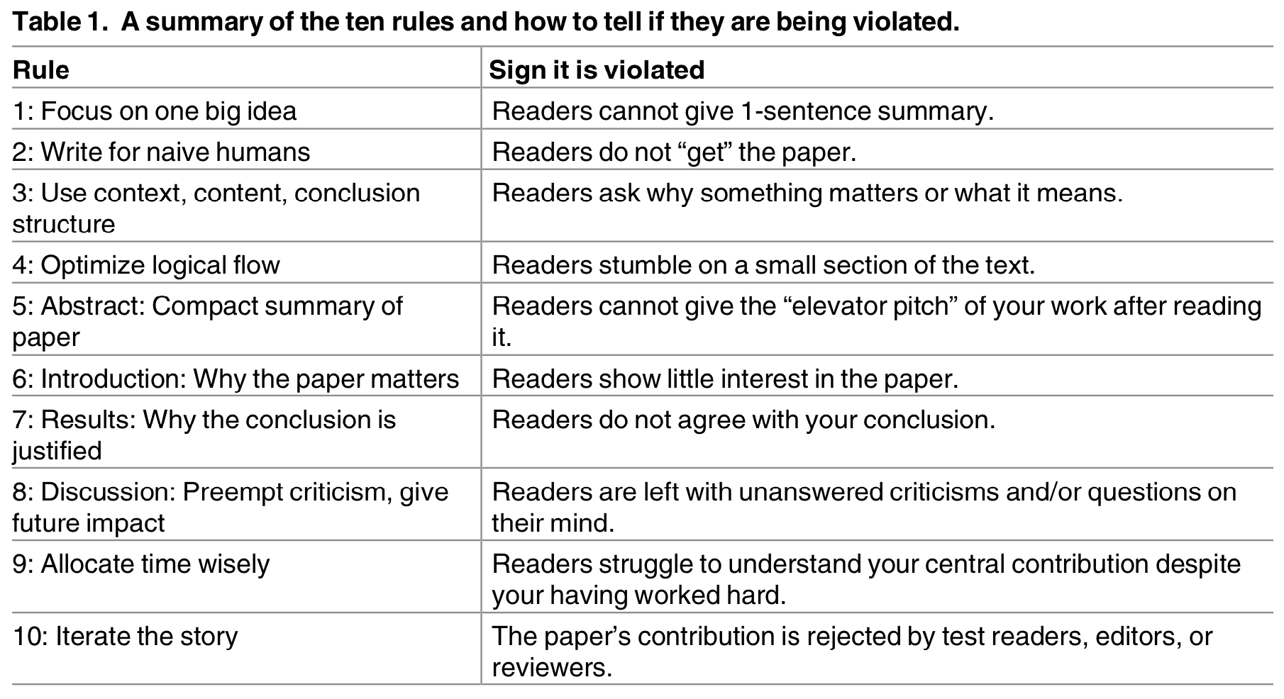
3. Big picture (or, what makes a paper “good”?)

Slide 16
A helpful checklist compiled from previous lectures:
Does the Introduction start broadly and end with the objectives?
Does the Introduction give only enough of the approach to understand what is to come – some information but not too much detail?
Does the Methods section reveal what was done, where the data came from, and any other special features, but not disclose the results? Sample size, period of record, and such things are often in the Methods if they are needed to understand the study design, though they may appear in the Results.
Does the Results section present all the available data needed to test all the hypotheses but no extraneous information?
Does the Results section avoid interpretation, apologies and other junk?
Are the sample sizes, treatments and controls, replicates clear?
Do all figures and tables have complete, self-explanatory captions?
Are figures and tables easy to understand?
Does the Discussion connect the key results with the hypotheses?
Does the Discussion integrate the findings with work by others?
Does the Discussion end with an appropriately broad connection back to the themes of the Introduction?

Slide 17
Today:
1. Work on incorporating feedback from Luke and peer reviews.
Submit these revised versions by Saturday night, using the template on canvas.

